Slide 1
Sensor Emulator Weekly
Aidan Dowdle
Slides from Ed Babroudi & IFIS Team
10 October 2023
CONTROLLED BY: U.S. NAVY, STRATEGIC SYSTEMS PROGRAMS CONTROLLED BY: SP23 FIRE CONTROL AND GUIDANCE BRANCH CUI CATEGORY CTI DISTRIBUTION/DISSEMINATION CONTROL: SEE BELOW POC: BRYAN BIGDA, BBIGDA@DRAPER.COM WARNING: THIS DOCUMENT CONTAINS TECHNICAL DATA WHOSE EXPORT IS RESTRICTED BY THE ARMS EXPORT CONTROL ACT (TITLE 22, U.S.C., SEC 2751, ET SEQ.) OR THE EXPORT ADMINISTRATION ACT OF 1979 (TITLE 50, U.S.C., APP. 2401, ET SEQ.), AS AMENDED. VIOLATIONS OF THESE EXPORT LAWS ARE SUBJECT TO SEVERE CRIMINAL PENALTIES. DISSEMINATE IN ACCORDANCE WITH PROVISIONS OF DOD DIRECTIVE 5230.25. DISTRIBUTION STATEMENT D: DISTRIBUTION AUTHORIZED TO THE DEPARTMENT OF DEFENSE AND U.S. DEPARTMENT OF DEFENSE CONTRACTORS ONLY. CRITICAL TECHNOLOGY 02 DECEMBER 2021. OTHER REQUESTS SHALL BE REFERRED TO DIRECTOR, STRATEGIC SYSTEMS PROGRAMS. DESTRUCTION NOTICE: DESTROY BY ANY METHOD THAT WILL PREVENT DISCLOSURE OF CONTENTS OR RECONSTRUCTION OF THE DOCUMENT.

Slide 2
Key Messages
New staff member in FPGA/HDL area – Jeff Stearns
For today – reviewing most recent emulator builds at Draper (GCAPS/ICAPS)
SMEs please feel free to weigh in while going through this
Requested information on RASP sensor – first candidate for emulator prototype

Slide 3
The Task 4521 HWIL Team
Paul Germain
Program Manager (A)
Bryan Wasileski
Technical Director
Aidan Dowdle
Task Lead
Lou DeMaria
GHWIL Sub-TL
Embedded Software
Visualization
IT support
RT Sim
I&T
Systems
HDL/FPGA
LE2 Emulator
Rich Mather
Jason Karlin
Daniel Reveron
Michael Nguyen
Kevin Baptista
Curt Schroeder
Eric Larson
Steve Nguyen
Daniel Fitzwater
David Stuart
Freddy Aguayo
Kurt Lucas
Geoff Falade
Christian Anzueto
Jeff Stearns
Hamilton Clower
Shawn Chambers
Avery Minkin
New to the team
= Draper
= Crane
= GD-MS

Slide 4
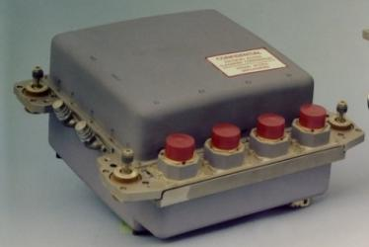
GCAPS/ICAPS Overview
In the GHWIL, emulators connect to the E1-E3 interface of the Mark 6 MOD 1 EA
Historically done using GCP cards
For GHWIL refresh:
ICAPS is the E1 emulator (Inertial Measurement Unit)
GCAPS is the E2-E4 emulator (Fire Control for E2, Flight Control EA for E3, testport for E4)
E3
E4
E1
E2
Figure from Guidance 101 – Guidance System Design

Slide 5
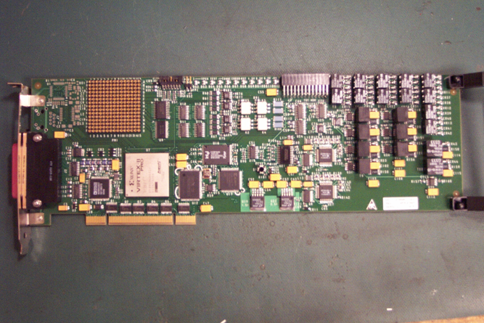
GCP Cards Used in GHWIL Today
GCP Card (Digital)
PCI form factor
Memory Mapped I/O
Xilinx FPGA
Multiple I/O (RS-422)

Slide 6
IFIS GCAPS /GIAS Architecture
Slide from Ed Babroudi’s IMU Emulator Proposal slides

Slide 7
GCAPS to ICAPS HW Transformation
Slide from Ed Babroudi’s IMU Emulator Proposal slides

Slide 8
ICAPS Architecture
GCAPS Enclosure
IEMU Interface
Card
Reuse
IAM
Module
47 MHz Ref_Clk
VHDCI
2400 Hz SYNC (Diff)
Reuse
NTIP
PFI
Missing Pulse
Detector
On Board 47.0016 MHz Oscillator
GS EA
(E1 Interface)
HB, LB, 2400 Hz SYNC, GIE_BRK
SSDN Interfaces
2400 Hz
SYNC (TTL)
HB, LB, PFI_REQ
iHawk
STM
STM Interface
Reuse
COTS
ZCU102
Module
RCIM Card
GbE
Shutter PHA/PHB Drive
30VSB
(ON)
50V
(OFF)
30VSB (2.5A), 50V (2A), 30VOP (?A)
COTS Chroma Load(s)
Slide from Ed Babroudi’s IMU Emulator Proposal slides

Slide 9
ICAPS Phy Layer Interface Card
For SSDN Interfaces copy CME5 and CME2 circuits. Transformer coupled interfaces using RS422 Tx, and LVDS Rx. Be sure to use LVDS buffers with fail safe biasing.
Use CIM module missing pulse detector circuit.
Somehow need to detect 30VSB application to transmit STM tone and detect 50V to disable STM tone. Careful not to mix GS 30V/50V power and returns with module power and ground. GS power / returns shall be isolated from module power and ground planes. Ask Tim Neugebauer for help.
Use PTM module pulse driver circuit for PFI_REQ and STM interfaces.
Terminate EA 47 MHz clk with high wattage resistor
Figure out if you need to install shutter motor load
IEMU Interface
Card
47 MHz Ref_Clk
PFI
Missing Pulse
Detector
VHDCI to IAM J1T
HB, LB, 2400 Hz SYNC, GIE_BRK
SSDN Interfaces
HB, LB, PFI_REQ
STM
STM Interface
Shutter PHA/PHB Drive
30VSB
(ON)
50V
(OFF)
+12V DC/Gnd
from IAM
I2C from IAM
if desired

Slide 10
GCAPS Reuse and New items for ICAPS
Reuse
New
IAM module
COTS ZCU102 Card
Fan Controller
ATX PS
VHDCI cable between IAM P1T and IEMU Interface card
GCAPS Internal harnesses (8880264, 8880265, 8880266)
GCAPS Enclosure bottom plate, sheet metal housing U-side and top
GCAPS internal mounting HW
ICAPS Interface card and frame. This module will be mounted in place of PSM on GCAPS bottom plate
ICAPS enclosure front and rear panel
New 79 pin panel mount Mil connector mounted on front panel for EA-IMU interface
Smaller Mil connector mounted on back panel to CHROMA loads
Slide from Ed Babroudi’s IMU Emulator Proposal slides

Slide 11
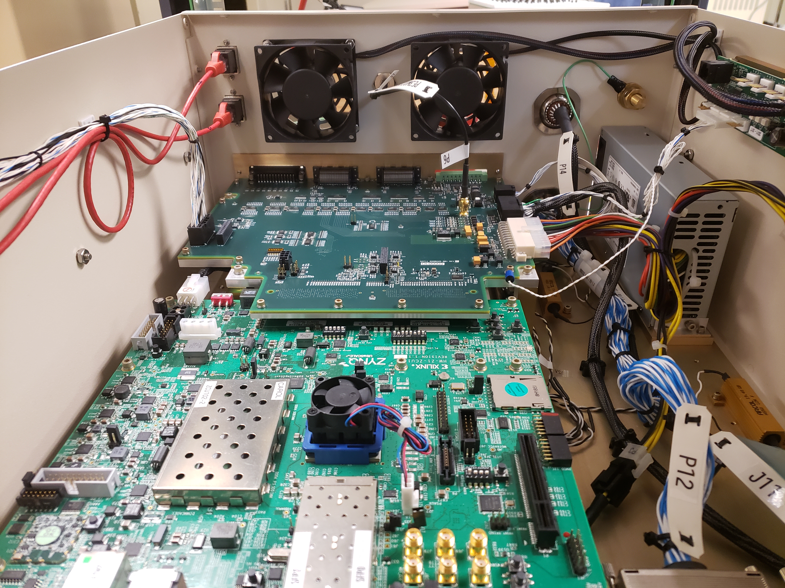
Reuse IAM, ZCU102, Fan Controller, Fan’s and ATX PS for EIMU
COTS Fan Controller
COTS ATX Power Supply
IEMU don’t need these
harnesses
Custom IAM Module
COTS ZCU102 Module

Slide 12
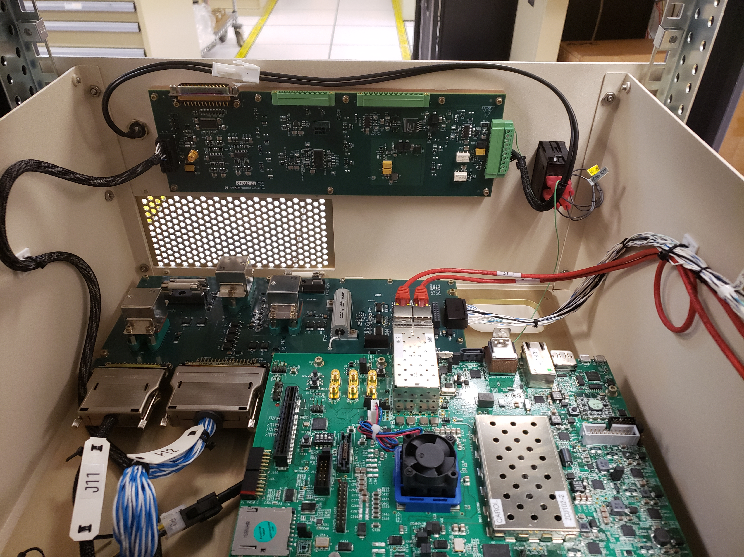
Remove PSM and SPM Modules
Don’t need this harness
Remove Status Panel
Module (SPM)
Reuse this harness +12V/Gnd
and I2C to IEMU interface card
Don’t need IAM to
PSM harness
Remove Power Switch
Module (PSM)
Install IEMU Phy Layer
Interface Card in place
of PSM

Slide 13
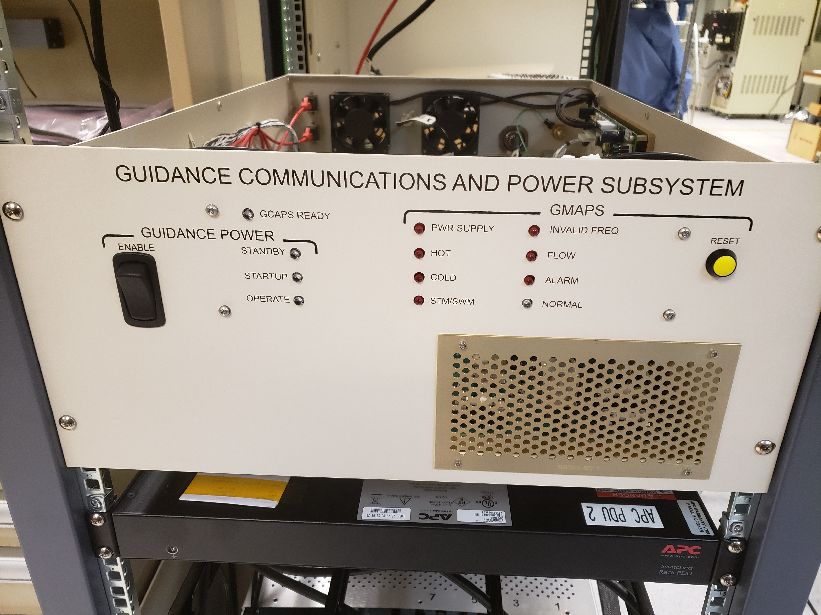
Need a new Front Panel
Need IEMU
Ready LED
EA-IMU Interface Connector
Don’t need rest of
LED’s or Switches
Move air intake
to the left
Install pseudo IJ1 Connector
somewhere here

Slide 14
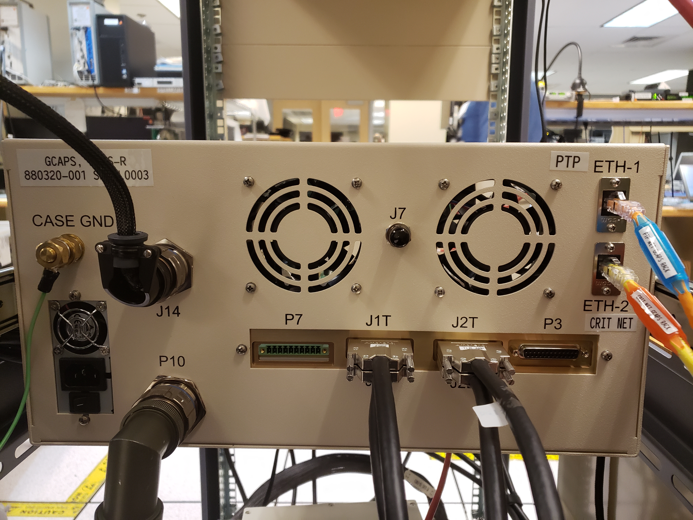
Need a new or slightly modified rear panel
Use this connector for power interfaces to CHROMA Loads
Don’t need this Connector
Cut a slot in here to loop and feed J1T VHDCI cable to IEMU Interface card. Probably you would need a shorter VHDCI Cable

Slide 15
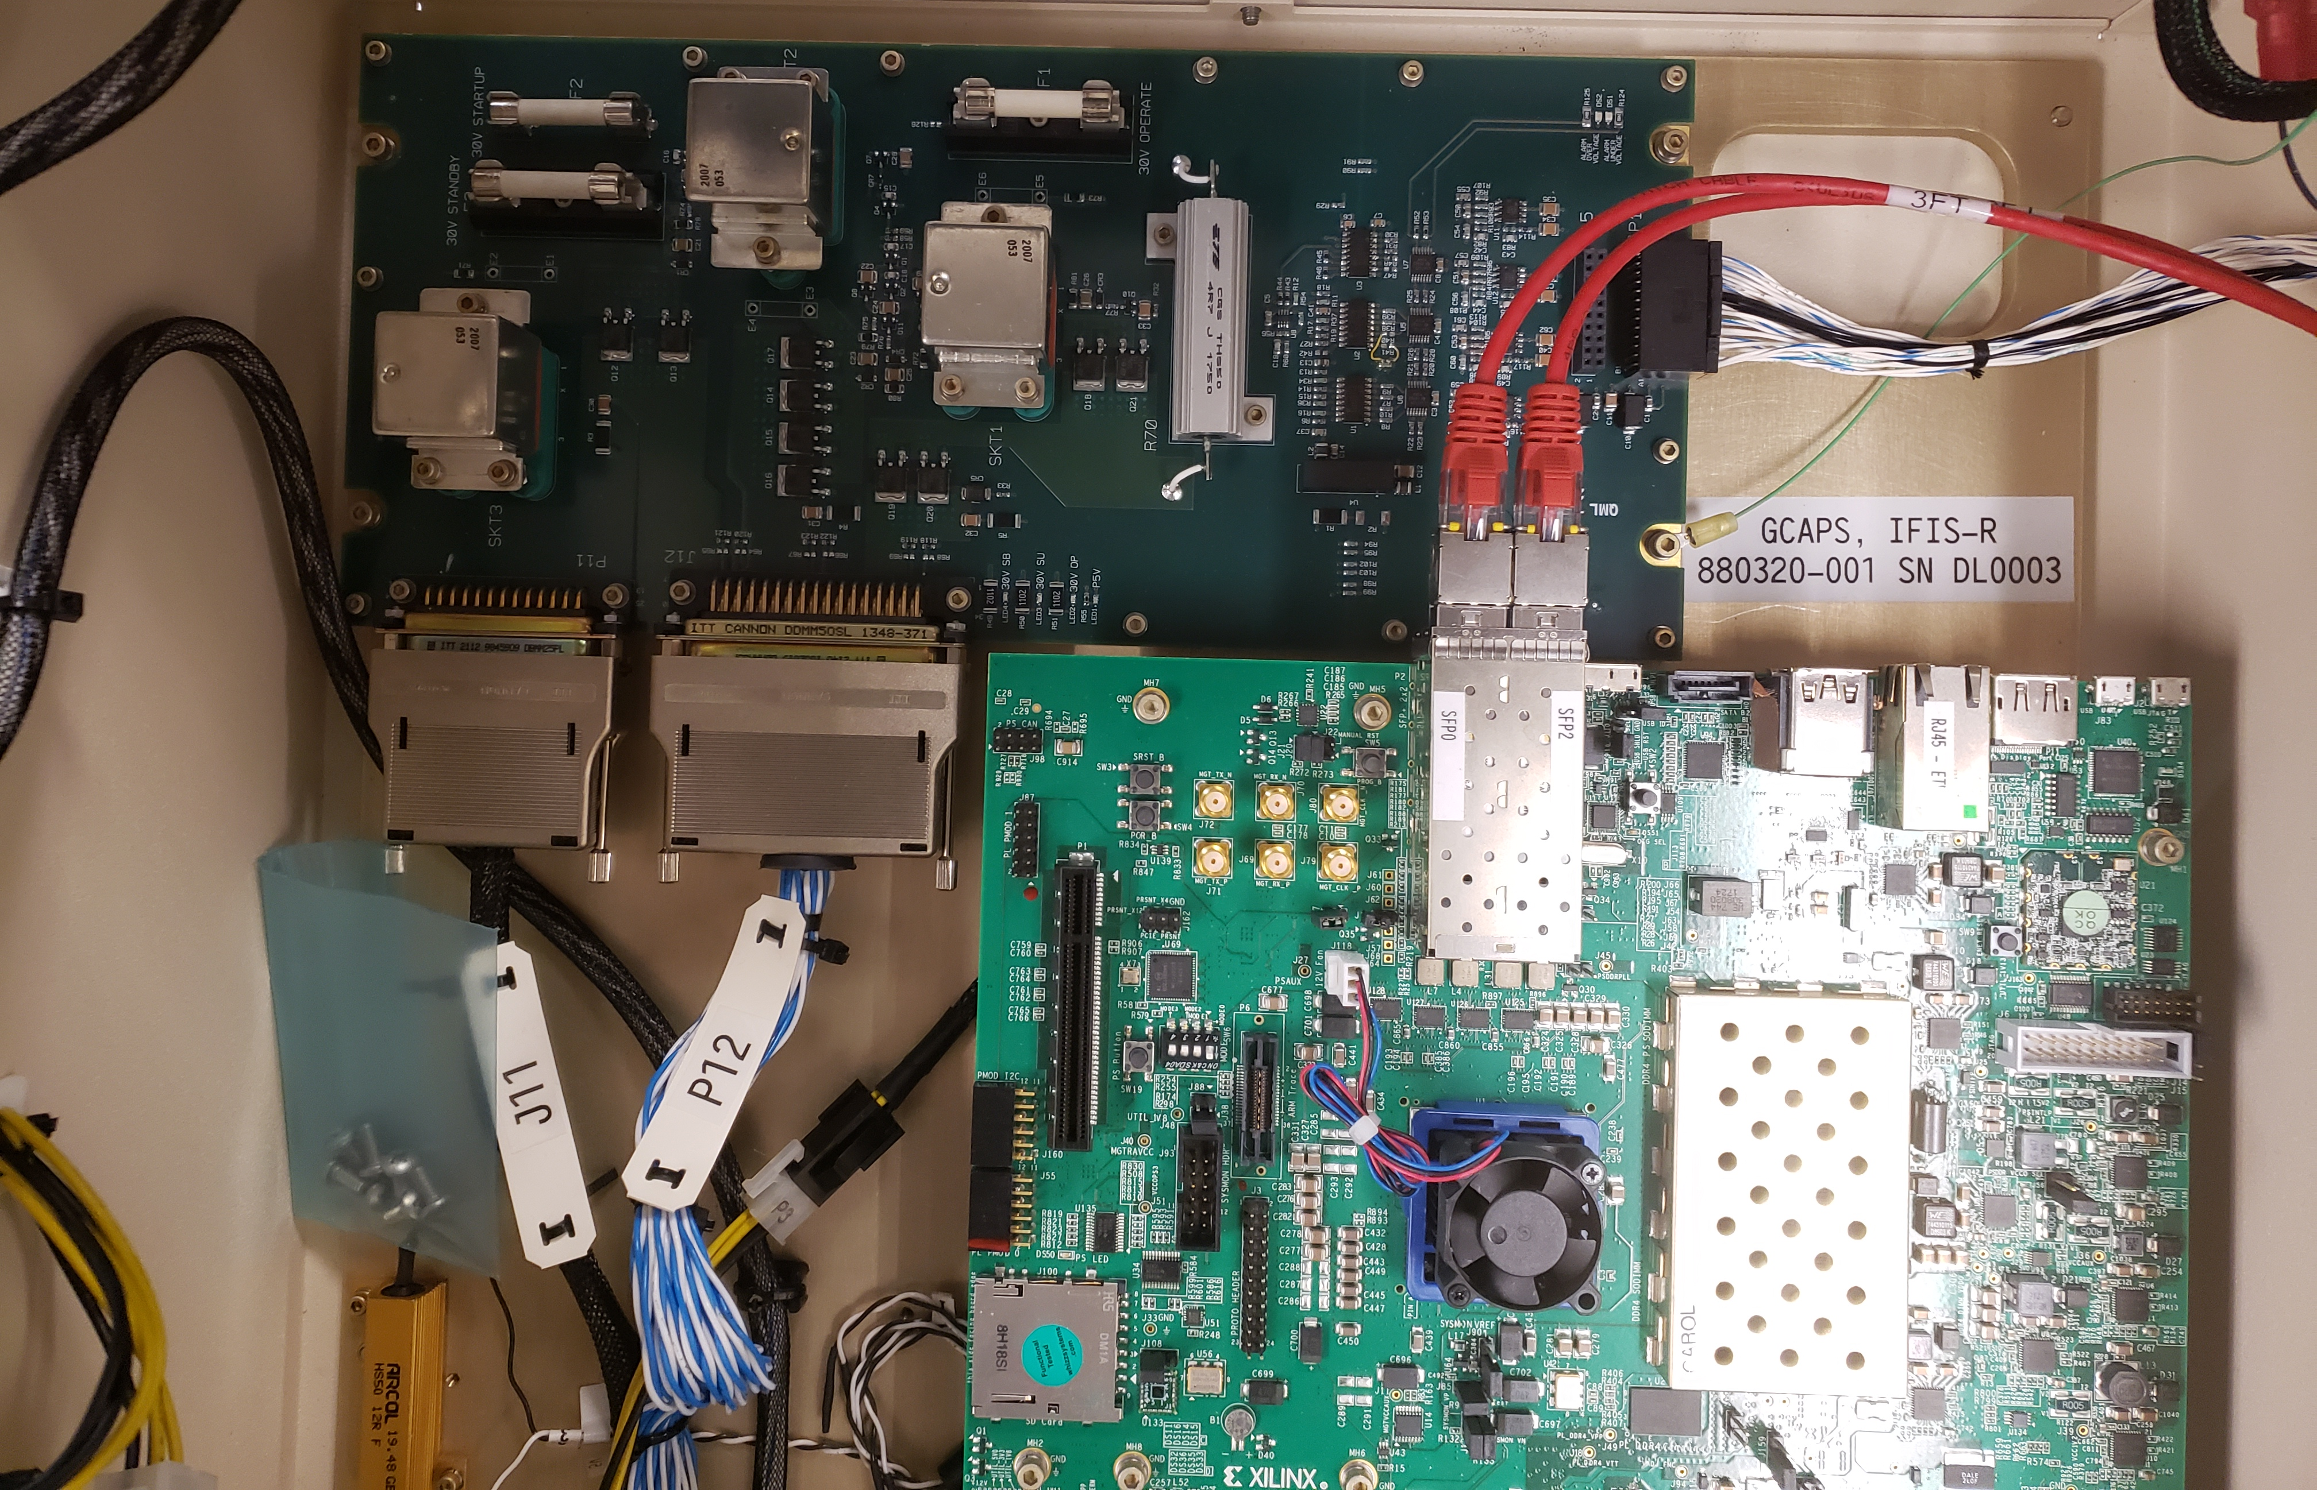
IEMU Interface Card I/O Connectors
New EIMU Interface Card
in place of PSM module
New Connector to accept former IAM to SPM +12V and I2C signals
Use DB25 Connector to feed EA-IMU signals, and copy of 30VSB and 50V power
VHDCI Connector and interface to IAM J1T Connector

Slide 16
Emulator Design – Inch-stones
Define requirements
Define concept
Identify architecture options
Complete cost-benefit analysis
Define architecture
Create implementation plan

Slide 17
Next Steps
Identify stakeholder/needs and start defining emulator requirements
PDU SCR slides show some possible HWIL configurations
Start learning about RASP accelerometer design
Requested documentation from Tristan Applefeldt/Karl Twelker
Survey of COTS parts/software for new emulator

Slide 18
Backup Slides

Slide 19
IMU Emulator Function (1 of 3)
Terminate GS EA 47 MHz Ref-Clk. IMU emulator (IEMU) will terminate GS Ref_Clk and uses internal 47 MHz clk for operation.
Receive FC GIE/Break discrete’s. Based on the state of GIE and Break emulate IMU prelaunch, post launch (flight), and in-flight recovery operation.
Synchronize with GS EA, establish TDMA communication with GS EA via SSDN interfaces and protocol. Use CME HUB HDL
Receive and process EA-to-IMU EA PFI signal (GS distributed Reset).
Generate IMU-to-EA PFI-Req signal (IMU is requesting system reset)
Process GS EA PFI signal (IMU comes out or goes to reset).
Generate and distribute IMU-to-EA PFI_Req signal (IMU requesting Reset from EA)

Slide 20
IMU Emulator Function (2 of 3)
Generate and distribute System Temperature Monitor (STM) tone.
Emulate IMU stellar camera shutter operation
Does EA shutter motor drive require a functional load to prevent damage to EA shutter motor drive module. Can we leave it open?
(Does IEMU required to sense when motor drive is applied?
Emulate Stelar camera sighting and transmit stellar data.
Emulate Platform Control Outer, Inner, Middle and Stable gimbal Resolver and Torque Motors.
Emulate PIGA wheel drive and 3x PIGA gyroscope sensors mounted on SM.
Emulate 3x IFOG sensors mounted on SM.

Slide 21
IMU Emulator Function (3 of 3)
Emulate IMU 3-axis vibration sensor mounted on Stable Member.
Emulate Stable Member Resolver and Motor side heaters.
Emulate Stable Member Dummy Heaters.
Receive and process SSDN EA-IMU SSDN messages.
Generate and transmit IMU-EA SSDN messages on time.
Emulate IMU Power Subsystem (PSS loads on 30VSB, 50V, and 30VOP).
Maybe additional functions not listed above.

Slide 22
IMU Emulator (IEMU) Synchronization with GS EA
During Prelaunch, GS EA will be synchronized to IFIS GCAPS. GS internal Ref Clk oscillator (HASO) is put in Track mode, which locks HASO output frequency to IFIS FG-BSY/FSY signals.
During Flight GS HASO is put in Hold mode and HASO is free running.
GS EA uses master SSDN Hub & TAD functions which provides 2400Hz Sync pulse and Sync Pulse message to IMU (E1) and Test Port (E4) slave SSDN Hubs.
IMU slave SSDN Hub(s) receive 2400Hz SP and SPM from EA and synchronize to EA SSDN timing. All SSDN data exchange between EA and IMU are synchronous TDMA operation.
IEMU will pass along GS EA 2400Hz SP to IEMU iHawk via NTIP.
Somehow, we must figure out a way to communicate the start of SSDN TDMA mode to IEMU iHawk via Ethernet. The start of TDMA mode marks the start of SSDN frame number zero.
GS EA after coming out of Reset (PFI), transmits bunch of SP’s prior entering TDMA mode. Wait period time change between prelaunch and Flight modes.

Slide 23
Synchronization between IFIS, GS (EA + IEMU) and TYCHO
IFIS Internal Timing is synchronized to Securesync 1PPS and 979.2KHz references
IFIS GCAPS uses internal 244.8 KHz (FGBSY), 2400Hz (SP), 600Hz, 300Hz, 100Hz, 10Hz (FGFSY) 2Hz, and 1Hz timing based on Securesync references.
IFIS GCAPS provides 2400Hz SP reference and 1Hz Sync Pulse message to IFIS iHawk.
IFIS GCAPS provides 244.8 Kbps FGBSY and 10Hz FGFSY to GS EA.
GS EA locks GS HASO oscillator 47.0016 MHz frequency to IFIS FGBSY/FSY clocks.
GS EA generates SSDN 2400Hz Sync Pulse and Sync Pulse Message inline with IFIS FGBSY/FSY reference clocks for E1 (GS IMU), and E4 (GS Test Port) interfaces.
TYCHO will be connected to GS E4 (Test Port). As such it will receive SSDN data and synchronization (2400Hz SP, and SPM) from GS EA.

Slide 24
Synchronization between IFIS, GS (EA + IEMU) and TYCHO
1PPS From
GPS or
Ship NAV
SecureSync
979.2 KHz
1PPS
FGBSY
244.8 KHz
GS
EA
IEMU
IFIS NTIP
IFIS GCAPS
GS 2400Hz SP
GS 2400Hz
SP (Diff)
IFIS NTIP
FGFSY 10 Hz
E2
E1
GS 2400Hz SPM
E4
1PPS
2400 Hz
GS 2400Hz
SP
GS 2400Hz
SPM
GS 2400Hz SP
IFIS iHawk
TYCHO
IEMU iHawk
GbE UDP messages
GbE UDP messages
IFIS SPM

Slide 25
Mod1 GS EA-IMU Electrical Interconnect
Signal Name | From | To | Signal Description
EA_CM_SSDN_HB_H/L | EA | IMU | EA to IMU downstream SSDN Data line (HB). 14-16 Mbps link
EA_CM_SSDN_LB_H/L | EA | IMU | Downstream SSDN Data line (LB).
EA_CM_SYNC_H/L | EA | IMU | SSDN Modulated Sync Pulse
EA_CM_GIE_BREAK_H/L | EA | IMU | Modulated Fire Control GIE and BREAK signals
EA_CM_REF_CLK_H/L | EA | IMU | GS Ref Clk, 47.0016 MHz, 7 V p-p, sinewave
EA_CM_PFI_H/L | EA | IMU | Guidance PFI Signal, 3.92 MHz, 9V –to- 11V p-p, sinewave
EA_CM_SHUT_PA/R | EA | IMU | IMU Shutter Open/Close, Phase A, Low freq, large amplitude signal
EA_CM_SHUT_PB/R | EA | IMU | IMU Shutter Open/Close, Phase B, Low freq, large amplitude signal
EA_IMU_30VSB/R (4 pairs) EA_IMU_30VSB_DH/R | EA | IMU | IMU 30VSB/DH power is used by SM End Heaters, and loads installed on IMU modules. (2.5A chroma load on 30VSB)
EA_IMU_30OP/R (8 pairs) | EA | IMU | 30VOP is used by platform control and PIGA Wheel Drive. Check with Tim N. about 30VOP loading.
EA_IMU_50V/R (3 pairs) | EA | IMU | EA Power Supplies create 50V from 30VSU for IMU use. 2A chroma load, 100W total,
CM_EA_SSDN_HB_H/L | IMU | EA | IMU to EA upstream SSDN Data line (HB)
CM_EA_SSDN_LB_H/L | IMU | EA | Upstream SSDN data line (LB)
CM_EA_PFI_REQ_H/L | IMU | EA | IMU PFI request signal
CM_EA_STM1_H/L (Do not implement) | IMU | EA | Don’t implement, this signal is used to detect MOD0 and Mod1 EA-IMU cross connect. Prevents FC from applying 30V power
CM_EA_STM2_H/L | IMU | EA | IMU System Welfare Monitor (sinewave)

Slide 26
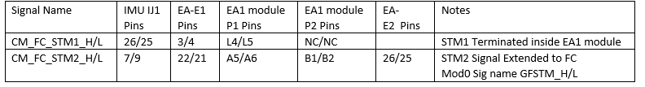
IEMU System Temperature Monitor (STM)
GS IMU generates and transmits System Temperature Monitor (STM Tone) to Fire Control as soon as 30VSB power is applied to GS.
IMU Emulator:
Shall always enable STM tone transmission, or within 50ms after application of 30VSB
Shall report STM Tone frequency of 1900Hz “Normal IMU” . See details for STM tone pulse amplitude, pulse width, and shape from GS to FC interface requirements
Shall disable STM tone transmission within 50ms after application of 50VDC
GS IMU generates and transmits two copies of STM tone to GS EA (STM1 and STM2 tones).
IMU Emulator:
Shall deliver STM2 tone to GS EA using IMU/IJ1 connector pins 7/9. See table below for additional detail
Notes:
Mod1 EA-IMU STM Tone Interconnect details
IMU Generates two STM tones on two pairs of wires (STM1 and STM2)
STM1 and STM2 tones enter EA-EA1 module via EA-E1 connector
STM1 Tone is terminated with 75 ohms in within EA-EA1 module
EA-EA1 module routes STM2 tone to Fire Control via EA-E2 connector

Slide 27
IEMU IEMU 30VSB, 50V, and 30VOP power loads
IMU Emulator shall draw:
2.5A from 30VSB
2A from 50VDC
?A from 30VOP. Consult Tim N.
Notes:
Mod1 EA-IMU STM Tone Interconnect details
IMU Generates two STM tones on two pairs of wires (STM1 and STM2)
STM1 and STM2 tones enter EA-EA1 module via EA-E1 connector
STM1 Tone is terminated with 75 ohms in within EA-EA1 module
EA-EA1 module routes STM2 tone to Fire Control via EA-E2 connector

